Slide 1
Confidentiality and Security for e-Health
C. Peter Waegemann
CEO, Medical Records Institute (MRI)
Chairman and Acting Director, Centre for the Advancement of Electronic Health Records (CAEHR) UK
Chair, Standards Committee ASTM E31 on Healthcare Informatics
Chair, US TAG to ISO TC 215 on Health Informatics
Chair, ISO TC 215 Task Force on Consumer Interests
Vice Chair, Mobile Healthcare Alliance (MoHCA)

Slide 2
What is e-Health?
Internet-enabled Healthcare Applications
  Consumer Health Information
  Personal Health Records
  Internet-based Services (e-Pharmacy, e-Care (incl. email and e-communication, etc.)
Electronic Health Record (EHR) Systems
Administrative and Financial Health Systems

Slide 3
Importance of Healthcare Security
Confidentiality/Data Security
What if something goes wrong?
  System’s Failure (Crash or virus causes loss of data)
  Outside force damages (hacker, other)
  Disaster
Design Issues (Signature, authentication, others)
Compliance Issues

Slide 4
How is Healthcare Security Different From Other Industries?
Not bilateral conditions
Regulated (US: HIPAA and other regulations)
Community interest
Legal issues

Slide 5
e-Health Security Issues
Security for (Patient) Confidentiality
Security that Enables Electronic Health Records
  Authentication
  Data Integrity
Systems Security
  Secure Transmission
  Secure Processing
  Secure Storage
  Etc.

Slide 6
Healthcare-specific Security Standards
Authentication
Identification
Signature
Non-repudiation
Data Integrity
Encryption
Data Integrity Process
Permanence
System Security
Communication
Processing
Storage
  Permanence
Internet Security
Personal Health Records
Secure Internet Services
General Security Standards
200+ Standards for Internet and
General Information Systems

Slide 7
Security on the Internet
Reliability of Health Information on the Net
Trust to e-care
Trust to e-pharmacy

Slide 8
Personal Health Records
Secure Documentation
Secure Storage
Relationship Between the Consumer/Patient and the Website Organization

Slide 9
ASTM E2211
Data Mining: For IIHI, PCHR suppliers shall allow consumers to choose if and how any personally identifiable information collected from them may be used. These choices shall be presented in a manner requiring that the consumer give specific permission for use of such data.
Policies: The PCHR supplier shall allow a consumer or other authorized individual easy access at any point in the PCHR application to the policies and standards to which the PCHR supplier site adheres, as well as their associated charges, if any.
Access: A PCHR supplier shall provide the consumer with the ability to access data within the PCHR in order to verify its correctness or to contest its accuracy and completeness, or both. Access policies shall describe the turnaround time related to such requests (time from request to access), shall specify associated charges, and shall include instructions for contesting and correcting inaccurate or incomplete data.
Integrity—A PCHR supplier must be able to assure data integrity through audit trails and other security methods and shall disclose its quality assurance policies regarding maintenance of data integrity.
Retention—The PCHR supplier’s disclosure statement shall state the length of time that the information will be stored and maintained.

Slide 10
Confidentiality
Confidentiality is Governed by Local/National Legislation and Provider Policies

Slide 11
E31.17 Privacy, Confidentiality and Access
Chair: Mary Alice Hanken (mahanken@u.washington.edu)
Scope: To develop standards that address access, privacy, confidentiality and data security of health information in its many forms and locations.
    E 1869 Guide for Confidentiality, Privacy, Access and Data Security Principles for Health Information Including Computer Based Patient Records
    E 1986 Standard Guide for Information Access Privileges to Health Information
    E 1987 Standard Guide for Individual Rights Regarding Health Information
    E 1988 Standard Guide for the Training Persons Who Have Access to Health Information
    PS 115 Provisional Standard Specification for Security Audit and Disclosure Logs for Use in Health Information Systems
Standards Under Development
    Draft PS 105 Provisional Standard Guide for Amendments to Health Information
    Draft Standard for Utilization and Retention of Encrypted Signature Certificates

Slide 12
Security for EHR Systems
Documentation Method
Authentication
Data Integrity
Systems Security

Slide 13
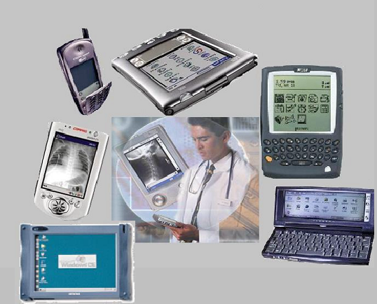
Mobile Health-
care
Communication and Computing Device
Any (small) portable and unobtrusive computing and/or telecommunications device that assists in the collection, retrieval or communication of data relevant to medical care

Slide 14
Mobile communications devices and healthcare
Situation:
  Mobile wireless devices are entering hospitals and other health care environments
  Device support applications providing increased productivity and decreased medical errors
  Past issues with wireless equipment give cause for concern and caution regarding potential issues in their usage
  Some institutions have issued bans
What is the appropriate security?
What security standards are needed?

Slide 15
RF Wireless already seen in hospital
Paging
Cellular (incl: Blackberry, RIM)
Wireless LAN (WiFi)
Wireless Medical Telemetry System (WMTS)
Bluetooth
Radio/TV stations

Slide 16
Wireless technology/application
30m
100m
150m
>1000m
>5000m
Wide Area/Mobile Network
Metropolitan Area Network
Cellular voice, data
30-100kb/s
Local Area Network
802.16
100Mb/s
802.11_
11-54Mb/s
Personal Area Network
802.15.1: Bluetooth
1Mb/s
VoIP
Connectivity
Networking

Slide 17
What Are General Mobile Health Computing (MHCD) Applications?
Handheld (Point-of-Care) Information Accessing Devices
Intermittently Connected Computing Devices
Locally (Always) Connected Computing Devices
Long-Range Connected Computing Devices

Slide 18
EMI/EMC
Three Approaches
Lack of Data on Risk
Varies by Technology: WiFi not as dangerous
Ad-hoc Testing

Slide 19
Has the Content Changed Since a Signature Has Been Affixed?
Need for Determination of Lower Threshold
Signature is to be Changed When Document is Changed or Deteriorated

Slide 20
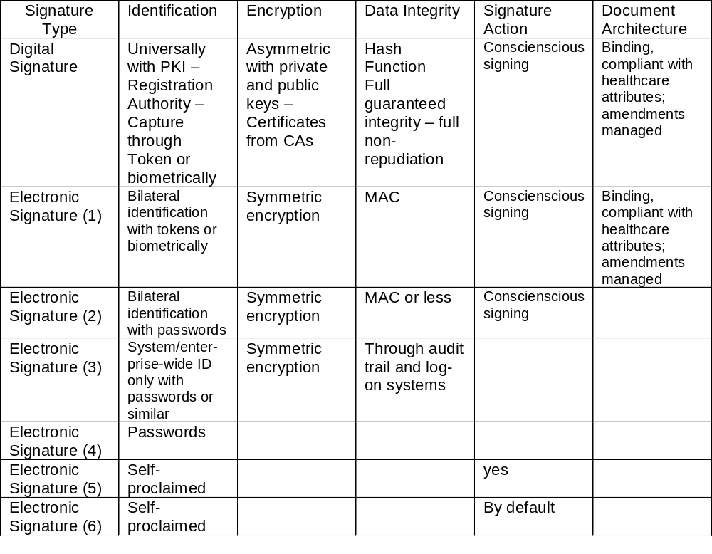
Best
Least Secure

Slide 21
Biometric Identification
Identification of Body Parts
  Fingerprint
  Retina Scan
  Face Scan
  Hand Scan
Identification of Person-specific Processes
  Keystroke Recognition
  Speech Pattern
  Writing/Signature

Slide 22
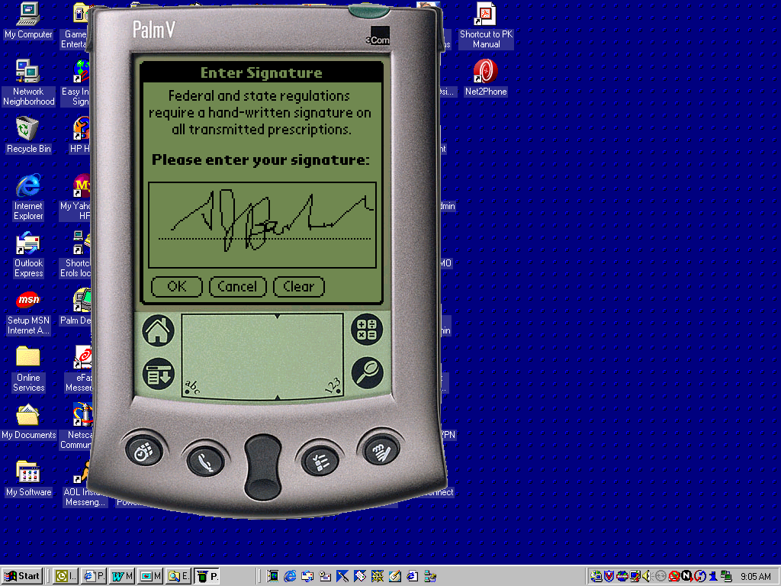
Beginning with e-Prescribing. Leveraging better ways of identifying ourselves to other services
Courtesy Andrew Barbash, MD
Notes:
EPHYSICIAN MOBILE PRESCRIPTION WRITING
Use of a commercially developed product within the KP environment.

Slide 23
System Security
Information Flow (Chain of Trust)
End-to-End (Point of Origination to Point of Access Security)
Stewardship Issues
Accountability
Audit
Access Control
Encryption
Trusted Data Stores
Trusted Communications
Data/Function Classification
User/Role Clearances
Non-repudiation
Signature Architecture
Back-up/Recovery

Slide 24
Performance
Response Time
  Systems failure if practitioner can do it faster and there are no other benefits
  Dependent on database and technical approaches
    Database server is bottleneck
Underlying Technology and Presentation/Navigation Issues
Scaling

Slide 25
Reliability: Unscheduled Downtime
99.9% Availability
99.999% Availability
8.76 unscheduled hours of non-availability
5.25 Minutes per Year

Slide 26
US National Standards
HIPAA
E31.20 Data and System Security for Health Information
E1714-00 Standard Guide for Properties of a Universal Healthcare Identifier (UHID)
E1762-95 Standard Guide for Electronic Authentication of Health Care Information
E1985-98 Standard Guide for User Authentication and Authorization
E2084-00 Standard Specification for Authentication of Healthcare Information Using Digital Signatures
E2085-00a Standard Guide on Security Framework for Healthcare Information
E2086-00 Standard Guide for Internet and Intranet Healthcare Security
E2212-02a Standard Practice Healthcare Certificate Policy
E31.22 Health Information Transcription and Documentation
E1902-02 Standard Guide for Management of the Confidentiality and Security of Dictation, Transcription, and Transcribed Health Records

Slide 27
Regional and International Standards
CEN TC 251
ISO TC 215
Others

Slide 28
Survey
www.medrecinst.com/resources/survey/survey03/index.shtml
There is a notable contrast between sectors regarding inappropriate access to patient records by authorized users within the organization
  IHDSOs are very concerned
  Solo/Small practices are much less concerned
The greatest concern of the Solo/Small practices is ‘Access to patient record information by unauthorized users’
The Ambulatory sectors are less concerned about ‘Violations of data security policies and practices’

Slide 29
Data Security Guidelines,
Standards, or Features
Implemented or Planned
In general, the use of data security protections is fairly high for:
    Access control methods
    Protection of data over networks
    Protection of data within the enterprise
The area where data security protection is least implemented is authentication of users.

Slide 30
Data Security Guidelines,
Standards, or Features
Implemented or Planned
IHDSOs have significantly higher levels of implementation; Hospitals are slightly above average; Medium/Large practices are about average; and Solo/Small practices fall significantly below average
IHDSOs are especially strong in implementing data security protection within the enterprise (i.e., policies and practices, backup/recovery procedures, and Audit logs)
In contrast, Solo/Small practices are weakest in implementing data security protection within the enterprise

Slide 31
Summary
How long will it take to implement a fully operable electronic health record?
  A long road ahead
The same applies to security standards
Practical security standards needed to cover the current status of EHR developments

Slide 32
Thank You
Attend:
Mobile Healthcare Conference
September 8-10 2003 Minneapolis Hilton
TEHRE 2003 London, England 2-3 December 2003 in conjunction with International ICT Marketplace
Survey on Electronic Health Record Usage and Trends http://www.medrecinst.com/resources/survey2002/index.shtml
www.medrecinst.com
Copies of these slides may be obtained by emailing peterw@medrecinst.com

